Slide 1
Operating Riak CS
May 7, 2013

Slide 2
Operating Riak CS
Architecture Overview
The Basics
Cluster Building
Riak CS Operations
Capacity Planning
Monitoring
Logs
Optimizations

Slide 3
Operating Riak CS
Architecture Overview

Slide 4
Architecture Overview
Riak Logical Architecture
Riak CS Logical Architecture
Riak CS Physical Architecture

Slide 5
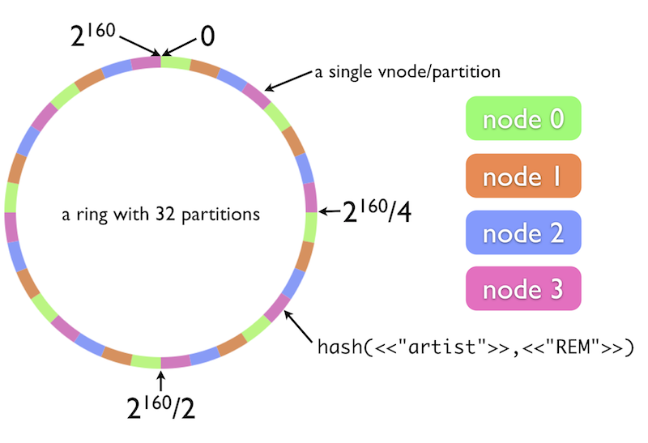
Riak Logical Architecture
Notes:
Riak has a 160bit integer key space
Key space is partitioned into vnodes based on the ring_creation_size parameter in app.config
Vnodes are distributed as evenly as possible between nodes
Consistent hashing is used to generate a sha1 of the bucket/key combination and place that on the ring
Consistent hashing enables masterless lookup where data lives
Coordinating nodes allow any node to accept and internally route requests to appropriate authoritative nodes

Slide 6
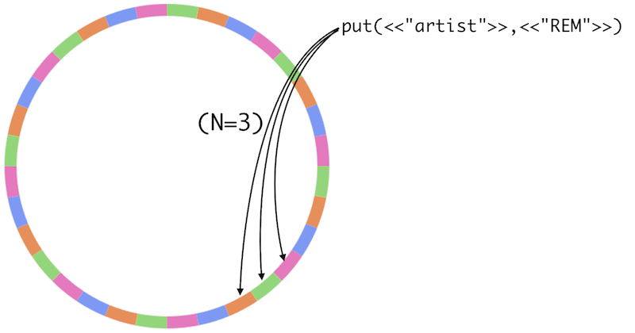
Riak Logical Architecture
Notes:
Failure resiliency is achieved by maintaining multiple copies of each object in N vnodes
Algorithm attempts to ensure each copy is spread across N nodes
When one node fails, 2 copies of data are still online
During failure, secondary vnodes take over for the unavailable primaries.
Handoffs occur when the node comes back online to pass any missed writes to the primary vnode

Slide 7
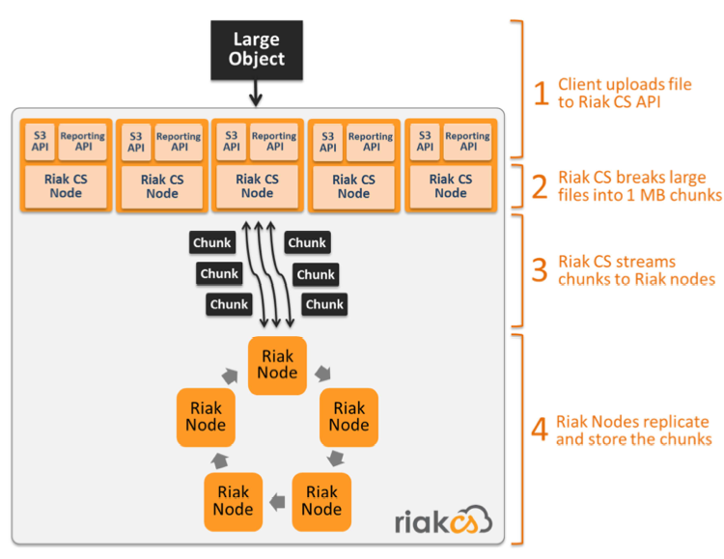
Riak CS Logical Architecture
Notes:
Riak CS is a thin proxy on top of Riak
CS has 3 main functions:
Expose and implement an S3-compatible API
CRUD
Multi-tenancy
Access controls per bucket and per file
Chunk large files into 1MB blocks
Provide usage and storage reporting

Slide 8
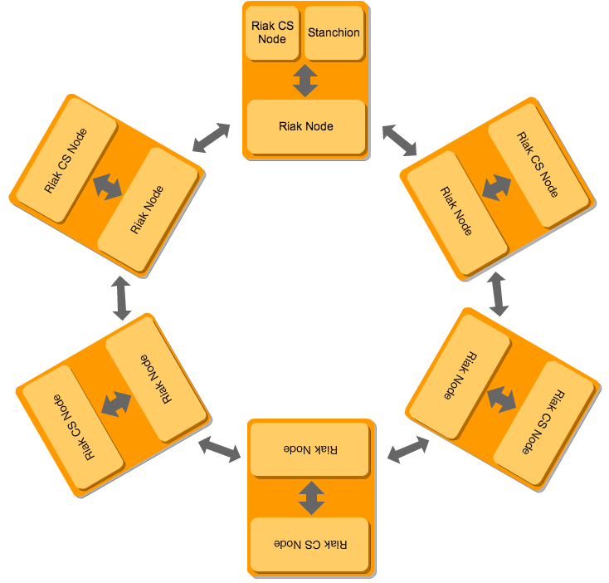
Riak CS Physical Architecture
Notes:
Riak CS is generally deployed alongside Riak on the same physical node
Reduces request latency
Riak and Riak CS have complementary resource utilization characteristics
Riak is only consumed by the Riak CS and Stanchion services and is not publically exposed
Riak CS is stateless and only communicates with its local Riak node and Stanchion
Riak CS nodes are load balanced via an external mechanism
Stanchion provides serialization for user creation and bucket creation/deletion requests (to ensure global uniqueness)
Stanchion is SPOF but standard Linux clustering techniques can be used to provide HA
Pacemaker
Heartbeat

Slide 9
Operating Riak CS
The Basics

Slide 10
The Basics
Files and Locations
Ports, Protocols, and Services
Basic Commands

Slide 11
Files and Locations
/etc/[ riak | riak-cs | stanchion ]
|__ app.config
|__ vm.args

Slide 12
Files and Locations
/usr/lib/[ riak | riak-cs | stanchion ]
|__ erts-5.9.1/
|__ lib/
|__ lib/basho-patches/
|__ releases/
Notes:
Erts-*: Erlang distribution
Lib: Riak CS libraries
Lib/basho-patches: directory where hot patches reside
Releases: specifies run time module versions for Riak CS at various installed Riak CS versions

Slide 13
Files and Locations
/var/lib/riak
|__ bitcask/
|__ leveldb/
|__ merge_index/
|__ ring/
|__ anti_entropy
Notes:
Bitcask: bitcask data files separated into directories by vnode
- leveldb: leveldb data files separated into directories by vnode
Ring: contains the Riak core ring file, a dbase3 file that is communicated between nodes to share the cluster state as well as extra shared info, such as repl status
Merge_index: backend storage for search indexes
Anti_entropy: leveldb store for anti-entropy trees

Slide 14
Files and Locations
/var/log/[ riak | riak-cs | stanchion ]
|__ console.log
|__ crash.log
|__ erlang.log
|__ error.log
|__ run_erl.log
Notes:
Console.log: all Erlang console output (debug file)
Crash.log: Erlang stack traces from crash events
Error.log: error-level output only from Erlang console
Run_erl.log: record of the runtime parameters Riak CS was started with

Slide 15
Files and Locations
/usr/sbin
|__ riak
|__ riak-admin
|__ riak-repl
Notes:
riak: useful to start/stop/ping riak
Riak-admin: primary cluster control script
Riak-repl similar to riak-admin but for managing MDC configuration and status

Slide 16
Files and Locations
/usr/sbin
|__ riak-cs
|__ stanchion
|__ riak-cs-gc
|__ riak-cs-access
|__ riak-cs-storage
Notes:
Riak-cs: useful to start/stop/ping riak
Riak-cs-gc: allows you to manually initiate GC
Riak-cs-access: allows you to manually flush access cache to archives
Riak-cs-storage: allows you to manually initiate storage calculations

Slide 17
Ports Protocols and Services
Protocol | Ports | Service
TCP | 4369 | epmd
TCP | 6000-7999 | Erlang inter-node communication
TCP | 8099 | Handoff listener
TCP | 8098 | HTTP client
TCP | 8087 | Protocol Buffers client
TCP | 9010 | Multi Datacenter Replication
TCP | 9080 | Cluster Manager
TCP | 8069 | Riak Control
UDP | 4000 | SNMP listener
TCP | 8080 | Riak CS API
TCP | 8085 | Stanchion
Notes:
8099 is used for transferring partitions during handoff
Epmd is an Erlang name server used to associate symbolic node names to machine addresses
6000-7999 is a configured port range in the Riak app.config used for inter-node communication between Erlang VMs
The Riak HTTP client listens on port 8098
The Riak Protocol Buffers client listens on port 8087
8080 – default S3 API port
8085 – CS communicates with Stanchion over this port

Slide 18
Basic Commands
/usr/sbin/riak
/usr/sbin/riak-cs
/usr/sbin/stanchion
{start | stop | restart | reboot | ping | getpid |
chkconfig | console | attach}
Notes:
Start: starts riak
Stop: stops riak
Restart: restarts Riak while leaving the Erlang VM running. Does not apply vm.args changes. Think of it as a “riak reload”
Reboot: stops Riak AND the Erlang VM, then starts Riak again. Think of it as a normal “restart”
Ping: runs an Erlang RPC ping against the Erlang VM to ensure it is loaded and accepting requests. Does not confirm Riak is fully loaded.
Getpid: returns the pid of the running Riak beam process
Chkconfig: checks the app.config file for syntactic errors
Console: starts riak and places you within the Erlang console. Useful for debugging startup errors
Attach: attaches you to the running Erlang console. Use ctrl-D to exit!

Slide 19
Basic Commands
/usr/sbin/riak-admin
{cluster join | cluster leave | cluster replace |
cluster force-remove}
Notes:
Leave: instructs a running node to transfer all of its vnodes to other nodes, leave the cluster, and then shut down
Replace: instructs a node to transfer all of its vnodes to another node, leave the cluster, and then shut down
Force-replace: reassigns all of the vnodes from node1 to node2 and then removes node1 from the cluster. The vnodes on node2 will be rebuilt via AAE
Force-remove: reassigns all of the vnodes from the node to other nodes and removes it from the cluster.

Slide 20
Basic Commands
/usr/sbin/riak-admin
{cluster | test | wait-for-service | ringready |
transfers | transfer-limit | down | cluster-info |
member-status | ring-status | status | diag | top}
Notes:
Test: completes a read/write cycle to riak_kv. Tests whether or not kv is loaded and if the node can complete read and write requests
Wait-for-service: command only returns once the specified service is running on the target node per riak_core_node_watcher. Useful for scripting.
Ringready: checks if all nodes agree on the ring state. Prints TRUE/FALSE accordingly. Useful to check once cluster membership has settled.
Transfers: lists any pending partition handoffs
Transfer-limit: allows you to set the partition handoff concurrency. Useful for speeding up the handoff process on an offline cluster.
Down: marks a node as down so that ring transitions can occur before that node is brought back online. Useful if you intend to fix a down node but have other ring operations to perform in the mean time.
Cluster-info: mainly useful for providing Basho support with detailed information about a cluster.
Member-status: prints the current status of all cluster members
Ring-status: gives you ringready output, any pending vnode ownership handoffs and a list of unreachable nodes (from the current node’s point of view)
Status: exposes Riak performance stats, internal counters, and some basic resource utilization metrics
Diag: executes the Riaknostic test suite against the local node
Top: gives you a top-like interface for what processes within the Erlang VM are doing. Useful for identifying bottlenecks or understanding resource utilization on a node

Slide 21
Basic Commands
/usr/sbin/riak-repl
{add-listener | del-listener | add-site | del-site | status | start-fullsync | cancel-fullsync | pause-fullsync | resume-fullsync}
Notes:
Add-listener:

Slide 22
Basic Commands
/usr/sbin/riak-cs-gc
{batch | status | pause | resume | cancel |
set-interval}
Notes:
Batch: manually starts garbage collection
Status: prints the current GC interval, last and next run times
Pause: pauses a running GC batch
Resume: resumes a paused GC batch
Cancel: stops a running or paused GC batch
Set-Interval: dynamically sets the GC interval in seconds. This setting will be lost on the next restart of the Riak CS node

Slide 23
Basic Commands
/usr/sbin/riak-cs-access
{ flush [-w <5s intervals>] }
Notes:
Flush: flushes the local access accumulation to the archiver and then pushes that into an archive object. Useful when taking the current server offline.
-w waits additional seconds before returning from each step. Default is 50 seconds for the push to the archiver and another 50 for the archive to be complete.

Slide 24
Basic Commands
/usr/sbin/riak-cs-storage
{ batch [--recalc] | status | pause | resume |
cancel }
Notes:
Used to manually trigger the Riak CS storage calculation.
If triggered on multiple nodes, the nodes will divide the users to be calculated between them
Batch: starts the storage calculation process on the current node.
Skips any user that was already calculated in the current archival period
Use –recalc to recalculate all users for the current archival period
Status: returns the current state of the storage daemon
Previous, current, next run times
Users processed in current run
Users left to be processed
Pause: pause an active batch
Resume: resume a paused batch
Cancel: cancel a running or paused batch

Slide 25
Operating Riak CS
Cluster Building

Slide 26
Riak CS Operations
Adding Nodes
Removing Nodes
Replacing Nodes
Configuring MDC Replication
Rolling Restarts
Upgrading Riak CS

Slide 27
Adding Nodes
Configure Riak, Riak CS IPs
Set Riak ring_creation_size
Configure Riak CS storage backend
Set allow_mult to TRUE
Join Riak node to cluster
Add Riak CS node to load balancer

Slide 28
IP Configuration
/etc/riak/app.config
{pb_ip, "10.121.9.164" },
/etc/riak-cs/app.config
{cs_ip, "10.121.9.164" },
{riak_ip, "10.121.9.164" },
{stanchion_ip, "10.121.8.252" },
{admin_ip, "10.121.9.165" },
Notes:
pb_ip: Riak CS and Stanchion communicate with Riak over the protobufs interface
cs_ip: interface for the Riak CS S3 API to listen on
riak_ip: IP of the Riak instance CS will communicate with
stanchion_ip: IP of the stanchion instance CS will communicate with
admin_ip: optional, set this to restrict all admin functionality to a separate interface from the S3 API interface

Slide 29
ring_creation_size
/etc/riak/app.config
{ring_creation_size, 128},
Must be a power of 2
Should not exceed 1024
All nodes must agree
Notes:
1024 limit is due to scaling issues with secondary indexes for values greater than 1024
All nodes in all clusters connected via MDC must agree

Slide 30
Riak CS Storage Backend
{add_paths, ["/usr/lib64/riak-cs/lib/riak_cs-1.3.0/ebin"]},
{storage_backend, riak_cs_kv_multi_backend},
{multi_backend_prefix_list, [{<<"0b:">>, be_blocks}]},
{multi_backend_default, be_default},
{multi_backend, [
{be_default, riak_kv_eleveldb_backend, [
{max_open_files, 50},
{data_root, "/var/lib/riak/leveldb"}
]},
{be_blocks, riak_kv_bitcask_backend, [
{data_root, "/var/lib/riak/bitcask"}
]}
]},

Slide 31
allow_mult
/etc/riak/app.config
{default_bucket_props, [{allow_mult, true}]},
Notes:
Enables sibling creation on conflict
Riak CS has rules for resolving conflicts
Enables proper order of operations to be taken on manifest modifications during eventually consistent convergence
Allows multiple nodes to write access log archives concurrently

Slide 32
Join Riak Nodes
riak-admin cluster join <riak@node>
riak-admin cluster plan
riak-admin cluster commit
riak-admin transfers
Notes:
Riak-admin cluster plan shows the nodes to be added/removed and how the vnodes will be redistributed
Watch riak-admin transfers to know when all transfers have been completed

Slide 33
Remove Riak Nodes
riak-admin cluster leave
riak-admin cluster plan
riak-admin cluster commit
Notes:
Riak-admin cluster leave instructs the current node to hand off all of its vnodes and then shut down
If the node to be removed is damaged and can’t hand off cleanly, use force-remove instead

Slide 34
Replace Riak Nodes
riak-admin cluster replace
riak-admin cluster plan
riak-admin cluster commit
Notes:
Riak-admin cluster replace instructs the current node to hand off all of its vnodes and then shut down
If the node to be removed is damaged and can’t hand off cleanly, use force-remove instead

Slide 35
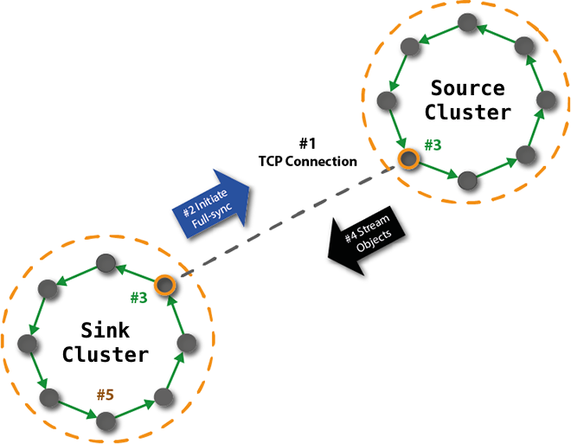
Configuring MDC Replication
Notes:
Each replication connection is unidirectional and operates independently of all other configured conncetions
Leader nodes are elected to facilitate handshakes, full sync calculations, and real time repl
Listeners are configured on the source cluster
A “site” is the target/destination/sink cluster
Full syncs occur on schedules or can be started via a cron

Slide 36
Configuring MDC Replication
riak-repl add-listener <site> <ip> <port>
riak-repl add-site <ip> <port> <site>
Notes:
Add listeners to all nodes in all clusters
Run add-site from each cluster to the other
Only needs to be run once for each site

Slide 37
Configuring MDC Replication
riak-repl add-listener <site> <ip> <port>
riak-repl add-site <ip> <port> <site>
/etc/riak/app.config
{fullsync_on_connect, true},
{fullsync_interval, 360},
Notes:
Add listeners to all nodes in all clusters
Run add-site from each cluster to the other
Only needs to be run once for each site
Fullsync_on_connect: whether or not to initiate a fullsync on the initial connection from the secondary cluster
Fullsync_interva: the interval at which fullsyncs will automatically start. This is measured from the end of the previous fullsync to the beginning of the next

Slide 38
Rolling Restarts
Check riak-admin ringready
Check riak-admin transfers
riak-cs-access flush
riak-cs stop; stanchion stop; riak stop
riak start; stanchion start; riak-cs start
riak-admin wait-for-service riak_kv
Move to next node
Notes:
Riak-admin ringready should report TRUE
Riak-admin transfers should NOT show pending transfers for current node
Service start order matters since Riak is a dependency for Stanchion, which is a dependency for Riak CS

Slide 39
Upgrading Riak CS
Verify Riak status (ringready/transfers)
Install new Riak, Riak CS, and Stanchion packages
Make any required changes to app.config
Execute Rolling Restart
Notes:
When installing Riak on RHEL-based systems, use `yum install` rather than `rpm –Uvh` to avoid dependency issues
Riak CS should generally be installed with its equivalent Riak version

Slide 40
Operating Riak CS
Riak CS Operations

Slide 41
Riak CS Operations
Garbage Collection
Usage Recording
Storage Statistics

Slide 42
Garbage Collection
Object is changed
Old version status set to “pending_delete”
GC daemon runs every 15 minutes
Removed if change time > leeway_seconds
Disk space reclaimed on Bitcask merge
Notes:
All objects in Riak CS are immutable. Writes and deletes create new versions.
Old versions added to a 2i
GC daemon removes object versions in the 2i older than leeway_seconds

Slide 43
Garbage Collection
/etc/riak-cs/app.config
{leeway_seconds, 86400},
{gc_interval, 900},
{gc_retry_interval, 21600},
/usr/sbin/riak-cs-gc
Notes:
Leeway_seconds: the number of seconds to retain an old version of an object before it is deleted
Used to give the delete indication time to propagate
Defaults to 24 hours
Gc_interval: the interval between GC batches
Defaults to 15 minutes. Set to ‘infinity’ to disable.
Gc_retry_interval: how often the GC daemon should retry moving a manifest to the GC bucket in Riak.
Accounts for corner cases where the first operation encountered a transient Riak error
Defaults to 6 hours
Riak-cs-gc can manually start a GC batch or be used to reset the gc_interval on the fly

Slide 44
Usage Recording
Log: user, access type, response size
Cached in memory on each node
Flushed to archive in Riak
Flushes based on time or log size

Slide 45
Usage Recording
/etc/riak-cs/app.config
{access_archive_period, 3600},
{access_log_flush_factor, 1},
{access_log_flush_size, 1000000},
{access_archiver_max_backlog, 2},
Notes:
Access_archive_period: how long each archive period is in seconds. Adjust to affect the size of the object stored in Riak
Access_log_flush_factor: how often data is flushed from memory to the archive
Must divide evenly unto the archive period
Increase to flush the log more frequently (decrease potential log data loss or cost of large flushes)
Access_log_flush_size: the maximum number of log entries that can accumulate in memory before a flush is forced
Access_archiver_max_backlog: the number of archives that can backup within CS before they are skipped. Meant as a safety valve to prevent running out of memory when CS is running behind

Slide 46
Usage Recording
/etc/riak-cs/app.config
{access_archive_period, 3600},
{access_log_flush_factor, 1},
{access_log_flush_size, 1000000},
{access_archiver_max_backlog, 2},
Notes:
Access_archive_period: how long each archive period is in seconds. Adjust to affect the size of the object stored in Riak
Access_log_flush_factor: how often data is flushed from memory to the archive
Must divide evenly unto the archive period
Increase to flush the log more frequently (decrease potential log data loss or cost of large flushes)
Access_log_flush_size: the maximum number of log entries that can accumulate in memory before a flush is forced
Access_archiver_max_backlog: the number of archives that can backup within CS before they are skipped. Meant as a safety valve to prevent running out of memory when CS is running behind

Slide 47
Usage Recording
/usr/sbin/riak-cs-access
{ flush [-w <5s intervals>] }
Notes:
Flush: flushes the local access accumulation to the archiver and then pushes that into an archive object. Useful when taking the current server offline.
-w waits additional seconds before returning from each step. Default is 50 seconds for the push to the archiver and another 50 for the archive to be complete.

Slide 48
Storage Statistics
Statistics tracked on a per-user basis
Scheduled or manual batch process
Executed as a MapReduce job
Multiple nodes can participate
Notes:
Calculates per-user storage utilization
Does not factor in N value
No schedule defined by default. Should be scheduled for off-peak times
MapReduce is fairly resource intensive
Not necessary to configure all nodes with a storage schedule. If more than one are configured, they will not duplicate effort.

Slide 49
Storage Statistics
/etc/riak-cs/app.config
{storage_schedule, [“0500”]},
{storage_archive_period, 86400},
Notes:
Storage_schedule: defines when (UTC) the storage calculation should begin
Can define more than one per day
Storage_archive_period: defines the resolution of the statistics
Defaults to one day
Should have one storage_schedule per period

Slide 50
Storage Statistics
/usr/sbin/riak-cs-storage
{ batch [--recalc] | status | pause | resume |
cancel }
Notes:
Used to manually trigger the Riak CS storage calculation.
If triggered on multiple nodes, the nodes will divide the users to be calculated between them
Batch: starts the storage calculation process on the current node.
Skips any user that was already calculated in the current archival period
Use –recalc to recalculate all users for the current archival period
Status: returns the current state of the storage daemon
Previous, current, next run times
Users processed in current run
Users left to be processed
Pause: pause an active batch
Resume: resume a paused batch
Cancel: cancel a running or paused batch

Slide 51
Operating Riak CS
Capacity Planning

Slide 52
Capacity Planning
Initial Capacity
Scaling Profile
Scaling Thresholds

Slide 53
Initial Capacity
How many objects?
What size are the objects?
Object count change over time?
What is your access profile?

Slide 54
Access Profile
How many requests per second?
What is the request distribution?
How are you querying?

Slide 55
Bottlenecks
Riak KV | Riak CS
Disk I/O | CPU
Network | Network
Memory | Memory
CPU | Disk I/O
Notes:
Riak CS disk IO is limited to logging

Slide 56
Estimating Disk Capacity
Estimating Disk Capacity
disk space per node
(objects * size * N)
nodes * (1 + ( ) )
% free space
100

Slide 57
Estimating Disk Capacity
Estimating Disk Capacity
disk space per node
(1MM * 100kb * 3)
5 * (1 + ( ) )
35
100
= 77GB per node

Slide 58
Riak Scaling Profile
Ideal model scales linearly
Practical efficiency
5-7 nodes: 0.8 * peak/n
8-80 nodes: 0.85 * peak/n
Failure overhead
-1.2 * peak/n

Slide 59
Riak Scaling Profile

Slide 60
Riak Scaling Profile
Peak req/s = 1000
Node count = 5
Node Count | Throughput | Delta
4 | 760 | -240
5 | 1000
6 | 1160 | +160
7 | 1314 | +154

Slide 61
Choosing ring_creation_size
Can only be set once
All nodes must agree (MDC as well)
10-50 vnodes per node is best

Slide 62
Operating Riak CS
Monitoring

Slide 63
Monitoring
System Metrics
Service Status
Riak Metrics
Tools

Slide 64
System Metrics
Metric | Threshold
CPU | 75% * num_cores
Memory | 70% - buffers
Disk Space | 75%
Disk IO | 80% sustained
Network | 70% sustained
File Descriptors | 75% of ulimit
Swap | > 0KB

Slide 65
Service Status
riak ping or /ping
riak-cs ping
stanchion ping
riak-admin test
riak-admin ring_status

Slide 66
Service Status
$ riak ping
pong
GET /ping
OK

Slide 67
Service Status
$ riak-admin test
Successfully completed 1 read/write cycle to 'riak@node1.cluster'

Slide 68
Service Status
$ riak-admin ring_status
==================== Claimant ====================
Claimant: 'riak@node1.cluster'
Status: up
Ring Ready: true
================= Ownership Handoff =================
No pending changes.
================== Unreachable Nodes ================
All nodes are up and reachable

Slide 69
Riak Metrics
$ riak-admin status
1-minute stats for 'riak@node1.cluster'
-------------------------------------------
vnode_gets : 192
vnode_gets_total : 131555
vnode_puts : 12
vnode_puts_total : 17287
vnode_index_reads : 277
node_get_fsm_time_mean: 756
node_get_fsm_time_median: 726
node_put_fsm_time_mean: 1098
node_put_fsm_time_median: 1012
Notes:
- Also available in JSON via HTTP interface at /stats

Slide 70
Riak Metrics
Multi-Data Center Replication Stats
$ riak-repl status
leader: 'riak@s3r1.ewr1'
{dropped_count,0},
{queue_length,0},
{queue_byte_size,0},
{queue_max_size,104857600},

Slide 71
Riak CS Metrics
<riak-node>:8080/riak-cs/stats
block_get: Total BLOCK GET operations performed
block_put: Total BLOCK GET operations performed
block_delete: Total BLOCK DELETE operations performed
service_get_buckets: Total GET BUCKETS operations performed
bucket_list_keys: Total BUCKET LIST KEYS operations performed
bucket_create: Total BUCKET CREATE operations performed
bucket_delete: Total BUCKET DELETE operations performed
bucket_get_acl: Total BUCKET GET ACL operations performed
bucket_put_acl: Total BUCKET PUT ACL operations performed
object_get: Total GET operations performed
object_put: Total PUT operations performed
object_head: Total OBJECT HEAD operations performed
object_delete: Total OBJECT DELETE operations performed
object_get_acl: Total OBJECT GET ACL operations performed
object_put_acl: Total OBJECT PUT ACL operations performed
Notes:
- Also available in JSON via HTTP interface at /stats

Slide 72
Monitoring Tools
Riak Enterprise
SNMP
JMX
Riak Nagios
https://github.com/basho/riak_nagios

Slide 73
Riak Nagios
$ check_node <check name>
node_up
riak_kv_up
file_handle_count
leveldb_compaction (errors)
riak_repl

Slide 74
Operating Riak CS
Logs

Slide 75
Logs
Log Configuration
Log Files
Common Error Messages

Slide 76
Log Configuration
/etc/riak/app.config
{lager, [
{handlers, [
{lager_file_backend, [
{"/var/log/riak/error.log", error, 10485760, "$D0", 5},
{"/var/log/riak/console.log", info, 10485760, "$D0", 5}
]},
{lager_syslog_backend, ["riak", daemon, info]}
]},

Slide 77
Log Configuration
Log File
Log Level
Max Size
Date
Max Files
{lager, [
{handlers, [
{lager_file_backend, [
{"/var/log/riak/error.log", error, 10485760, "$D0", 5},
{"/var/log/riak/console.log", info, 10485760, "$D0", 5}
]},
{lager_syslog_backend, ["riak", daemon, info]}
]},
Notes:
Log file: the absolute path to the log file
Log Level: Minimum severity to send to the log file. Options are: debug, info, notice, warning, error, critical, alert, emergency. Alert and emergency are not implemented.
Max Size: default is 10MB. Defines the file size threshold for rotating the file. Disable size-based rotation by setting the param to 0.
Date: defines when the file rotates using newsyslog syntax. Default is daily at midnight. Disable date-based rotation by setting to “”
Max Files: the maximum number of rotated files to keep before deleting the oldest one.

Slide 78
Log Configuration
Identity
Facility
Log Level
{lager, [
{handlers, [
{lager_file_backend, [
{"/var/log/riak/error.log", error, 10485760, "$D0", 5},
{"/var/log/riak/console.log", info, 10485760, "$D0", 5}
]},
{lager_syslog_backend, ["riak", daemon, info]}
]},
Notes:
Identity: string to tag all log messages within syslog. Defaults to “riak”
Facility: syslog facility to which to log the message
Log Level: the minimum Lager severity level to send to syslog

Slide 79
Log Configuration
{crash_log, "/var/log/riak/crash.log"},
{crash_log_msg_size, 65536},
{crash_log_size, 10485760},
{crash_log_date, "$D0"},
{crash_log_count, 5},
Notes:
Crash_log: the absolute path to the crash log file
Crash_log_msg_size: The maximum individual message size that can be logged. Messages larger than this limit will be truncated. Default is 64k
Crash_log_size: default is 10MB. Defines the file size threshold for rotating the file. Disable size-based rotation by setting the param to 0.
Crash_log_date: defines when the file rotates using newsyslog syntax. Default is daily at midnight. Disable date-based rotation by setting to “”
Crash_log_count: the maximum number of rotated files to keep before deleting the oldest one.
Not possible to send crash logs to syslog

Slide 80
Log Files
/var/log/[riak, riak-cs, stanchion]
|__ console.log
|__ error.log
/var/lib/riak/leveldb/*
|__ LOG
Notes:
console.log: most useful log for consuming via Splunk for analysis
error.log: alert on any new message logged here
leveldb logs: best to glob all logs and look for the string “Compaction error”
find /var/lib/riak/leveldb -name "LOG" -exec grep -H 'Compaction error' {} \;

Slide 81
Common Error Messages
Erlang
long_gc
busy_dist_port
Too many db tables
{error, e____}
Posix errors: http://erldocs.com/R15B/kernel/inet.html
Notes:
Long_gc: warning that garbage collection is taking too long. An indication that your systems need more memory
Busy_dist_port: distributed Erlang was unable to open a connection to another node. Usually indicates you need to increase +zdbbl in /etc/riak/vm.args
Too many db tables: Erlang was unable to allocate an ETS table. Most often encountered when using Riak Search. Increase ERL_MAX_ETS_TABLES in /etc/riak/vm.args.
{error, e___}: indicates the Erlang VM encountered a POSIX error when interacting with the OS. Examples: enoent (no such file or directory) or emfile (exceeded allowed file descriptors)

Slide 82
Common Error Messages
Riak
Bitcask
Failed to merge
LevelDB
Compaction error
Notes:
- Failed to merge: one of your Bitcask data files is likely corrupted. Most common solution is to truncate the file
Compaction error: one of your LevelDB SST files is corrupt. The corrupt

Slide 83
Operating Riak CS
Optimizations

Slide 84
Optimization
OS Tuning
Riak Tuning
Riak CS Tuning

Slide 85
OS Tuning
Sysctls
Mount options
I/O scheduler

Slide 86
OS Tuning
/etc/sysctl.d/riak.conf
vm.swappiness = 0
net.ipv4.tcp_max_syn_backlog = 40000
net.core.somaxconn=4000
net.ipv4.tcp_timestamps = 0
net.ipv4.tcp_sack = 1
net.ipv4.tcp_window_scaling = 1
net.ipv4.tcp_fin_timeout = 15
net.ipv4.tcp_keepalive_intvl = 30
net.ipv4.tcp_tw_reuse = 1
# For 10Gb Networks
net.core.rmem_default = 8388608
net.core.rmem_max = 8388608
net.core.wmem_default = 8388608
net.core.wmem_max = 8388608
net.core.netdev_max_backlog = 10000
Notes:
Vm.swappiness: instructs the kernel to only swap to avoid an out of memory condition
tcp_max_syn_backlog: keeps more SYN requests in memory. Helps moderate the effect of a large number of connections at peak times.
net.core.somaxconn: increases the max TCP sockets in a LISTEN state
tcp_timestamps: we’ve seen performance benefits while disabling this option on networks less than 10GbE. This should be enabled on 10GbE networks.
tcp_sack: enables selective ACKs. Helps reduce the amount of data sent during retransmits.
tcp_window_scaling: enables window scaling. Reduces bandwidth loss on high bandwidth connections.
tcp_fin_timeout: how long to keep sockets in the FIN_WAIT_2 status. Default: 60. Decreasing helps reap closed connections faster.
tcp_keepalive_intvl: the interval between sending keepalive probes. Default: 75. Decreasing allows failed connections to be closed sooner.
tcp_tw_reuse: allow reusing sockets in TIME_WAIT state for new connections

Slide 87
OS Tuning
Mount Options
EXT4: noatime,nodiratime,barrier=0,data=writeback
XFS: noatime,nodiratime,nobarrier,logbufs=8,logbsize=256k,allocsize=2M
Notes:
Both Riak backends are append-only and can tolerate end of file corruption. It is preferable to optimize for long-term throughput than for crash-time consistency.
Riak does not require atime, disable it
Barriers ensure proper write ordering by forcing a flush to media for any given commit before the next flush may begin. Not necessary when using modern RAID controllers, external storage, or for Riak in general.
Data=writeback allows data to be flushed to disk AFTER its metadata is committed to the journal. This is an optimization that favors throughput over consistency.
Logbufs specifies the number of in-memory log buffers. Increasing this value will generally improve performance at the cost of greater memory consumption. 8 is the max
Logbsize specifies the log buffer size for each log buffer. Default is 32k. Increasing this value will allow more file modifications to be kept in memory, improving performance
Allocsize specifies how much space will be pre-allocated for files in order to reduce fragmentation

Slide 88
OS Tuning
/sys/block/X/queue/scheduler
noop
deadline
/sys/block/x/queue/nr_requests
1024
Notes:
Scheduler defines the algorithm by which data is flushed to disk.
Noop tends to work best with network-based file systems since they implement their own flush algorithm
Deadline works best for direct attached storage
The default scheduler is CFQ and tends to be _very_ bad for Riak performance
nr_requests defines the depth of the scheduler queue. Default is 128. Longer queues allow for more efficient ordering and increased probability of merging requests.

Slide 89
Riak Tuning
/etc/riak/vm.args
-name riak@riak1.node
-setcookie riak
+K true
+A 64
+W w
-env ERL_MAX_PORTS 4096
-env ERL_CRASH_DUMP /var/log/riak/erl_crash.dump
-env ERL_FULLSWEEP_AFTER 0
-env ERL_MAX_ETS_TABLES 8192
+P 256000
+S 64:64
+swt very_low
+zdbbl 32768

Slide 90
Riak Tuning
/etc/riak/app.config
{eleveldb, [
{cache_size, 8388608},
{data_root, "/var/lib/riak/leveldb"},
{max_open_files, 100},
{write_buffer_size_max, 62914560},
{write_buffer_size_min, 31457280}
]},
Notes:
- max_open_files defaults to 20. We’ve found the best performance with values between 70-100.

Slide 91
Riak Tuning
/etc/riak/app.config
{bitcask, [
{merge_window, {1, 5}}, %% only merge between the hours of 1-5am
%% Trigger a merge if any of the following are true:
{frag_merge_trigger, 60}, %% fragmentation >= 60%
{dead_bytes_merge_trigger, 536870912}, %% dead bytes > 512 MB
%% Conditions that determine if a file will be examined during a merge
{frag_threshold, 40}, %% fragmentation >= 40%
{dead_bytes_threshold, 134217728}, %% dead bytes > 128 MB
{small_file_threshold, 10485760} %% file is < 10MB
]},
Notes:
- merge_window lets you specify when during the day merge operations are allowed to be triggered. Defaults to ‘always’ meaning merges can occur as necessary
- frag_merge_trigger describes what ratio of dead keys to total keys in a file will trigger merging
dead_bytes_merge_trigger describes how much data stored for dead keys in a single file will trigger merging
frag_threshold describes what ratio of dead keys to total keys in a file will cause it to be included in the merge
dead_bytes_threshold describes the minimum amount of data occupied by dead keys in a file to cause it to be included in the merge
small_file_threshold describes the minimum size a file must have to be excluded from the merge

Slide 92
Riak CS Tuning
/etc/riak-cs/app.config
{connection_pools,
[
{request_pool, {128, 0} },
{bucket_list_pool, {5, 0} }
]},
Notes:
request_pool: maximum number of concurrent requests the node will accept
bucket_list_pool: maximum number of concurrent bucket listings per node
Bucket listing is an expensive MapReduce operation

Slide 93
Operating Riak CS
Backups

Slide 94
Backups
Node Backups
MDC Cluster Backup

Slide 95
Node Backups
rsync
snapshots

Slide 96
Node Backups
/var/lib/riak
|__ ring
|__ bitcask
|__ leveldb
|__ merge_index
|__ anti_entropy
/etc/[ riak | riak-cs | stanchion ]
/usr/lib/riak/lib/basho-patches

Slide 97
Restoring Node Backups
Install Riak
Restore Riak directories
Join node to cluster
Mark old node down
Replace old node with new node
Force read-repair (pre-1.3 only)

Slide 98
Restoring Node Backups
# Join to any existing, cluster node
riak-admin cluster join riak@riak2.example.com
# Mark the old instance down
riak-admin down riak@riak1.example.com
# Force-replace the original instance with the new one
riak-admin cluster force-replace riak@riak1.example.com riak@riak6.example.com
# Display and review the cluster change plan
riak-admin cluster plan
# Commit the changes to the cluster.
riak-admin cluster commit

Slide 99
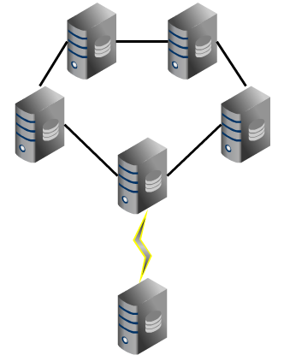
MDC Cluster Backup

Slide 100
Operating Riak CS
Backends

Slide 101
Backends
Bitcask
LevelDB
Multi Backend

Slide 102
Bitcask
Strengths
Low, predictable latency
Windowed merges
Supports object expiration
Weaknesses
All keys must fit in memory

Slide 103
LevelDB
Strengths
Supports 2i
Data compression
Not bounded by memory
Weaknesses
Latency increases w/data volume
Notes:
Uses Snappy compression
1.5–1.7x for plain text
2-4x for HTML
no compression for binaries

Slide 104
Multi Backend
{multi_backend, [
{be_blocks, riak_kv_bitcask_backend, [
{data_root, "/var/lib/riak/bitcask"}
]},
{be_default, riak_kv_eleveldb_backend, [
{cache_size, 8388608},
{data_root, "/var/lib/riak/leveldb"},
{max_open_files, 40},
{verify_checksums, true},
{write_buffer_size_max, 62914560},
{write_buffer_size_min, 31457280}
]}

Slide 105
Availability
99.9
99.99
99.999

Slide 106
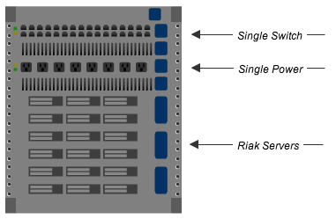
99.9
Notes:
8.76hrs downtime per year
Single Data Center
Single Rack
Non-redundant power
Non-bonded network

Slide 107
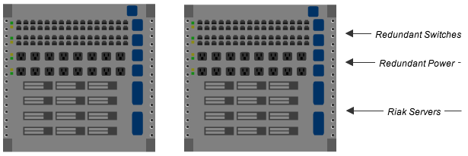
99.99
Notes:
52.56 minutes downtime per year
Single Data Center
Multiple Racks
Redundant Power
Bonded Network

Slide 108
99.999
`
Notes:
5.26 minutes downtime per year
At least 2 data centers
Multiple Racks
Redundant Power
Bonded Network

